Slide 1


Nick Driscoll
10/12/2022

Slide 2

Outline
Executive Summary
Introduction
Methodology
Results
Conclusion
Appendix

Slide 3
Executive Summary
Summary of methodologies
This study was conducted following the methodology outlined in the IBM Data Science Capstone. Most steps of the methodology were also conducted using multiple different techniques, for example:
Data collection was performed using Webscraping of Wikipedia and the SpaceX API
EDA was performed using SQL, pandas and visualization
Visualization was performed using matplotlib plotting of pandas DataFrames, Folium maps, and Plotly Dash dashboards
Predictive analysis was conducted using logistic regression, SVM, Decision Tree, and KNN models
Summary of all results
EDA uncovered insights and relationships between features that would be used as predictors: Flight Number, Payload Mass, Orbit, Launch Site
Training of multiple classification models produced the same classification accuracy performance

Slide 4
Introduction
SpaceX advertises that they can launch their Falcon 9 rocket with a cost savings of over 100 million dollars versus other competitors. The key is that they can land and re-use the first stage of the Falcon 9 rocket. Publicly available historical launch data for the Falcon 9 may help competitor companies predict what it takes to build a re-usable first stage rocket.
Using the historical launch data, which includes rocket parameters and results, a company may be able to build predictive Machine Learning models to identify if the first stage of the rocket will land or not.

Slide 5

Section 1

Slide 6
Methodology
Data collection methodology:
Data on SpaceX Falcon9 Launches is publicly available. It was procured in multiple ways; using the SpaceX API, and WebScraping the Falcon 9 Wikipedia page
Perform data wrangling
Filtered out rockets that were not Falcon 9, Calculated number of launches, occurrence of each orbit type, created binary landing outcome column
Perform exploratory data analysis (EDA) using visualization and SQL
Visualized: mission outcome by orbit type, mission outcome by launch location, size, weight, etc.
Used SQL Queries to identify distinct mission outcomes, booster version types, payload masses, and rank the successful mission outcomes
Perform interactive visual analytics using Folium and Plotly Dash
Plotted and categorized mission outcomes and site proximity to landmarks
Perform predictive analysis using classification models
Cleaned and split data into training/test sets, transformed with StandardScaler, trained Logistic Regression, SVM, Tree and KNN Models, and assessed performance using scoring metrics and Confusion Matrix against test data

Slide 7
Data Collection
Data sets were collected via the SpaceX API and the Webscraping
To access the SpaceX API, functions were defined to pull in data for the Booster Version, Launch Site, Payload information and other core data
Webscraping was performed on the Falcon 9 Wikipedia page. Similarly, functions were defined to pull date/time, booster version, landing status, mass from the Wikipedia table
Additional details are presented on the following charts

Slide 8
Data Collection – SpaceX API
Used the following calls to pull the ‘static’ json data
static_json_url = ‘…/datasets/API_call_spacex_api.json'
response = requests.get(static_json_url)
data = pd.json_normalize(response.json())
Additionally, called specific data from the following apis:
https://api.spacexdata.com/v4/rockets/
https://api.spacexdata.com/v4/launchpads/
https://api.spacexdata.com/v4/payloads/
https://api.spacexdata.com/v4/cores/
Create API Request
Import dataset into pandas DataFrame
Clean DataFrame
Use functions to pull necessary info from DataFrame
Allocate to dictionary
Save Dict to csv
https://github.com/ndriscoll20/IBMDataScience/blob/master/DataScienceCapstone/jupyter_notebooks/DataScienceCapstone_API_Scraping.ipynb

Slide 9
Data Collection - Scraping
Web Scraped from:
'https://en.wikipedia.org/wiki/List_of_Falcon_9_and_Falcon_Heavy_launches’
Assign html request to soup obj
Extract Table from HTML request
Create launch data dict
Extract html table data to launch data dict
Save Dict to csv
https://github.com/ndriscoll20/IBMDataScience/blob/master/DataScienceCapstone/jupyter_notebooks/DataScienceCapstone_Webscraping.ipynb

Slide 10
Data Wrangling
After data collection, data was cleaned and organized
Filter the data only by Falcon 9 data
Removing nulls and missing values
Find distribution of launches per site, per type of orbit, per booster version, per payload mass
Create a ‘landing’ outcome class to make the mission outcome binary
https://github.com/ndriscoll20/IBMDataScience/blob/master/DataScienceCapstone/jupyter_notebooks/DataScienceCapstone_Wrangling.ipynb

Slide 11
EDA with Data Visualization
We visualized the following, in order to gain an understanding of the relationships between features and to start forming a hypothesis of which features contribute to launch success
Flight Number vs. Payload Mass Categorized by Landing Success
Flight Number vs. Launch Site Categorized by Landing Success
Payload Mass vs. Launch Site Categorized by Landing Success
Success rate vs. Orbit Type
Flight Number vs. Orbit Type, Categorized by Landing Success
Payload vs. Orbit Type, Categorized by Landing Success
Landing Success over Time
https://github.com/ndriscoll20/IBMDataScience/blob/master/DataScienceCapstone/jupyter_notebooks/DataScienceCapstone_EDA_dataviz_pandas.ipynb

Slide 12
EDA with SQL
The following SQL Queries were executed in order to explore the dataset:
Unique Launch Sites
Launch Sites beginning with ‘CCA’
Total Payload Mass for NASA launches
Average Payload Mass for Falcon 9 V1.1
First Successful Landing
Names of Boosters that landed on Drone Ships between a certain weight
Total number of Successful and Failure Missions
Booster Version with maximum payload
Month of Failed Landings in 2015
Ranking of Successful Landing Outcomes
https://github.com/ndriscoll20/IBMDataScience/blob/master/DataScienceCapstone/jupyter_notebooks/DataScienceCapstone_EDA_w_SQL.ipynb

Slide 13
Build an Interactive Map with Folium
Folium was used to understand the location of different launches, their success rates, and proximity to landmarks
We used various folium map objects to identify unique features:
Markers were used to identify each unique launch location
Marker clusters and coloring were used to categorize launch success at each site
Lines were used to point to the closest landmarks such as coastlines, railways, highways and cities
Annotations were used to draw the distance to those landmarks
https://github.com/ndriscoll20/IBMDataScience/blob/master/DataScienceCapstone/site_map.html
https://github.com/ndriscoll20/IBMDataScience/blob/master/DataScienceCapstone/jupyter_notebooks/DataScienceCapstone_launch_sites_capstone.ipynb

Slide 14
Build a Dashboard with Plotly Dash
A Pie Chart was created with a site selection dropdown to show the distribution of successful launches across sites, as well as the ratio of success to failures per site
This chart allowed us to identify the sites with the most and least successful launches as well as the ratio of success for each individual site
A Scatter Chart plotted Payload mass against class (landing success or failure), categorized by booster version. This chart also had a slider bar which allowed us to filter the plot by payload size
This chart allowed us to understand how different booster versions were used for different payload sizes, as well as how different payload sizes and the booster version contributed to success
https://github.com/ndriscoll20/IBMDataScience/blob/master/DataScienceCapstone/python_code/capstonePlotlyDash.py

Slide 15
Predictive Analysis (Classification)
We used the feature-engineered dataset from the EDA lab to train our model
Data was split into training and test datasets, and the predictor data was transformed using the StandardScaler
GridSearchCV was used to optimize the input parameters for each classification model type
This method automatically performes optimization for us, so that we did not have to individually select, test, and evaluate the results of each possible input parameter
Models used for classification: Logistic Regression, SVM, Decision Tree, and KNN
Each model resulted in the same classification accuracy against the test dataset
The only model that varied from one execution of the script to the next was the decision tree. Ultimately, the best performing Decision tree had the same performance of the other models
https://github.com/ndriscoll20/IBMDataScience/blob/master/DataScienceCapstone/jupyter_notebooks/DataScienceCapstone_MachineLearning.ipynb

Slide 16
Results
Exploratory data analysis results
During EDA, data was cleaned by removing nulls, and filling in the average for missing data (payload size), filtering by the rocket of interest (Falcon 9)
New dummy variables were created for categorical variables and the landing outcome
Visualization and Interactive analytics demo in screenshots
Relationships between Flight Number, Payload Mass, Launch Location, Time, and landing success were uncovered
Mapping visualizations gave insights into launch locations, distribution of success across sites, and proximity to landmarks
Predictive analysis results
Each model resulted in the same classification accuracy against the test dataset
The consistency across models may be due to the small sample size in the test set (18 samples)

Slide 17

Section 2

Slide 18
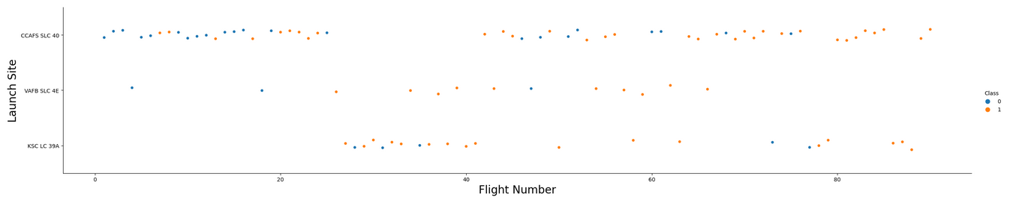
Flight Number vs. Launch Site
Success clearly increases as Flight Number increases
VAFB has a better success ratio
CCAFS CLC 40 has the most successes

Slide 19
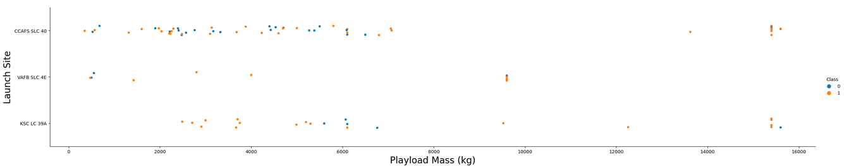
Payload vs. Launch Site
Success clearly increases as Flight Number increases
VAFB has a better success ratio
CCAFS CLC 40 has the most successes

Slide 20
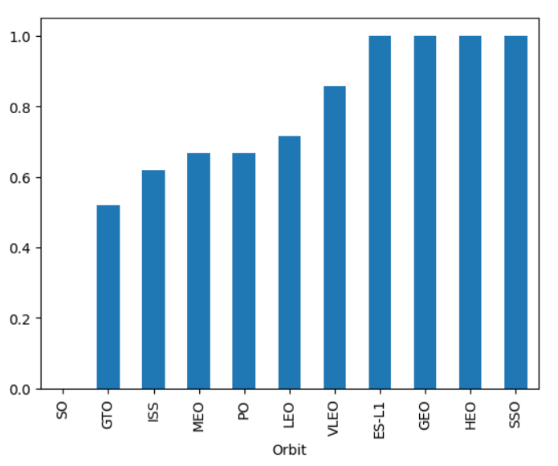
Success Rate vs. Orbit Type
S-L1, GEO, HEO and SSO all have a high degree of success
GTO and ISS have the lowest success rates

Slide 21
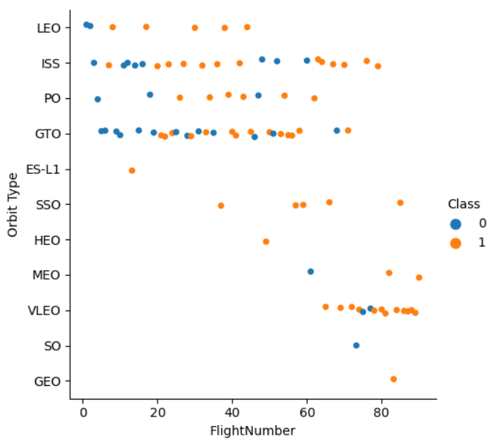
Flight Number vs. Orbit Type
Higher Flight numbers are typically VLEO orbits
LEO only had failures for initial flights
GTO and ISS have the most launches

Slide 22
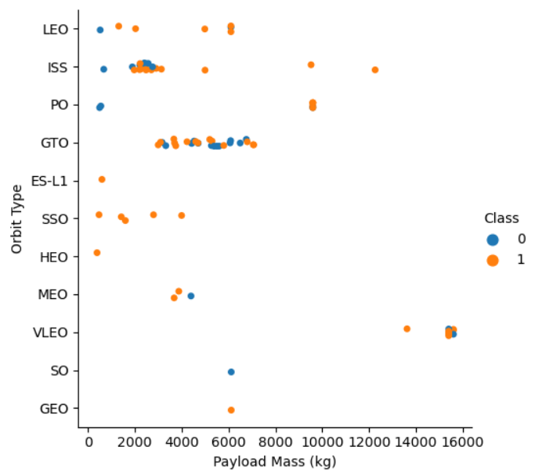
Payload vs. Orbit Type
Payload sizes are very concentrated to Orbit types
Higher Payload masses have better success than most

Slide 23
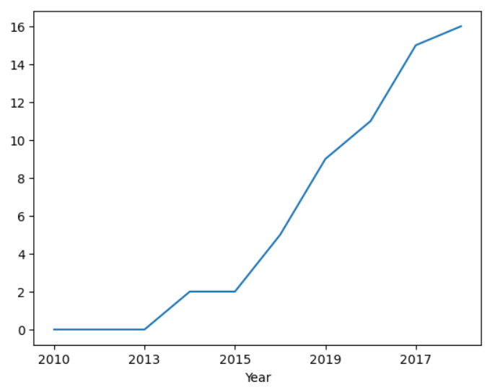
Launch Success Yearly Trend
This clearly depicts launch success getting better as the years increase

Slide 24
All Launch Site Names
There are 4 unique Launch Sites:
Launch Site
CCAFS LC-40
VAFB SLC-4E
KSC LC-39A
CCAFS SLC-40

Slide 25
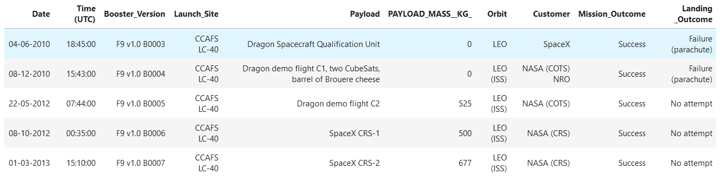
Launch Site Names Begin with 'CCA'

Slide 26
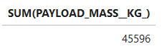
Total Payload Mass
Total payload carried by boosters from NASA

Slide 27
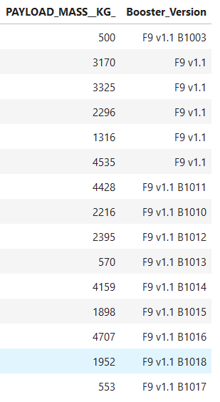
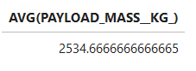
Average Payload Mass by F9 v1.1
Average:
All Payload Masses:

Slide 28
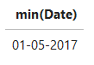
First Successful Ground Landing Date
The first Ground Pad Landing Success was

Slide 29
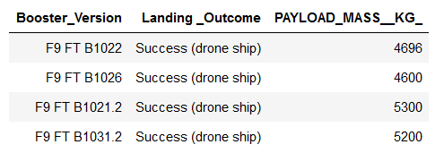
Successful Drone Ship Landing with Payload between 4000 and 6000
List the names of boosters which have successfully landed on drone ship and had payload mass greater than 4000 but less than 6000

Slide 30
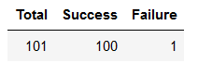
Total Number of Successful and Failure Mission Outcomes
Total number of successful and failure mission outcomes

Slide 31
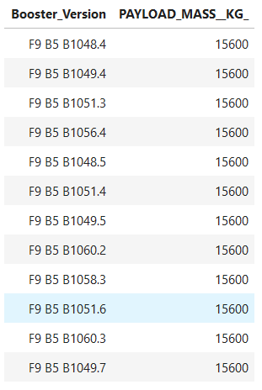
Boosters Carried Maximum Payload

Slide 32
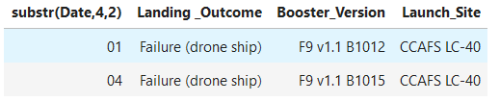
2015 Launch Records
Failed landing outcomes in drone ship, their booster versions, and launch site names for in year 2015

Slide 33
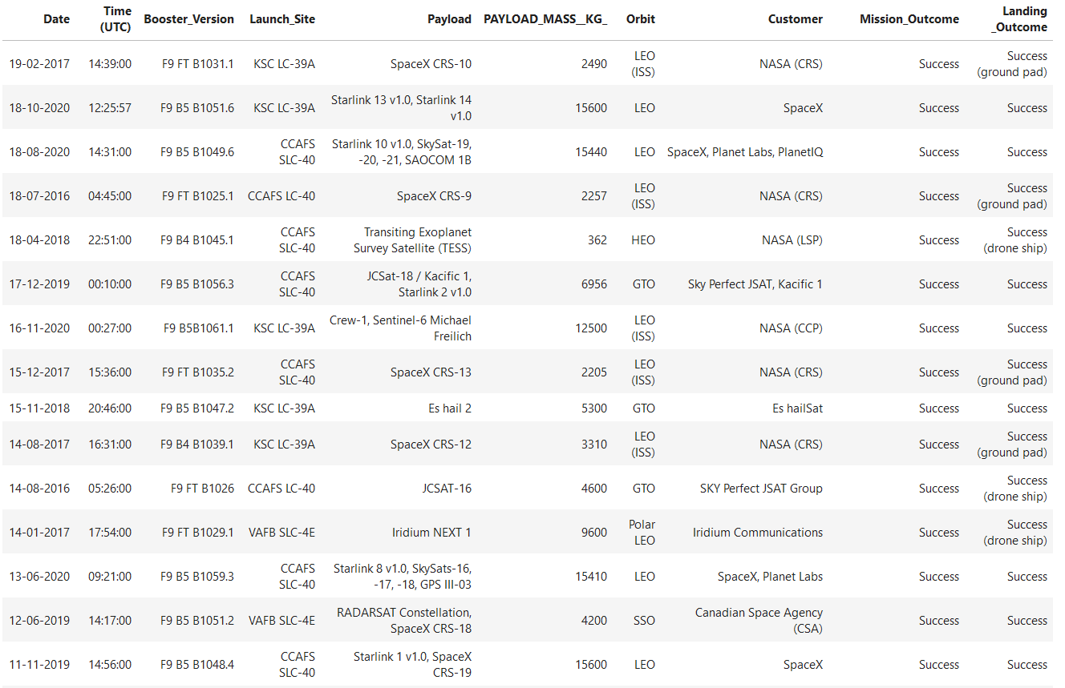
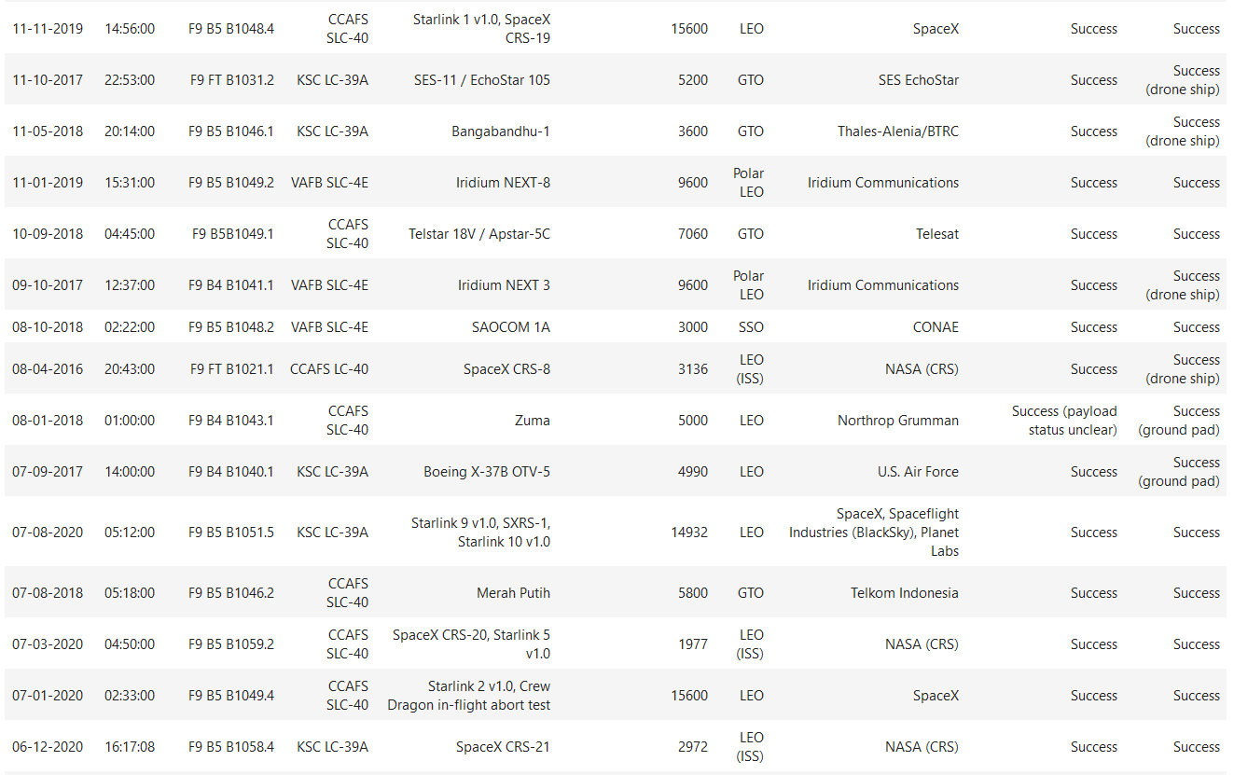
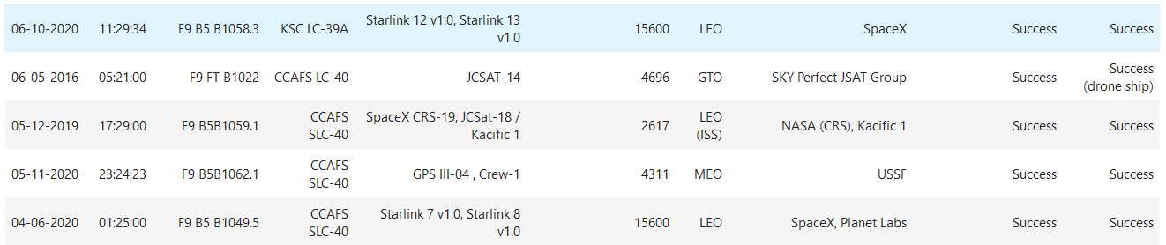
Rank Landing Outcomes Between 2010-06-04 and 2017-03-20

Slide 34

Section 3

Slide 35
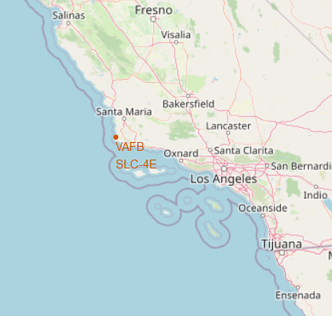
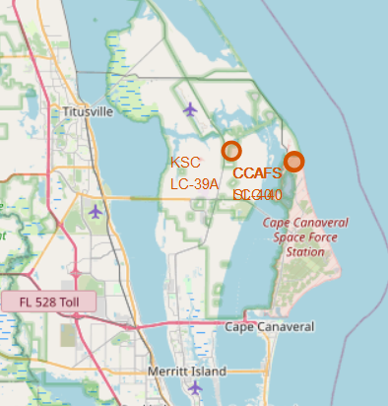
Folium Mapping – Launch Sites
KSC LC-39A
CCAFC SLC-40
CCAFS LC-40
VAFC: Vandenberg Air Force Center
KSC: Kennedy Space Center
CCAFS: Cape Canaveral Air Force Station
SLC: Space Launch Complex
LC: Launch Complex
VAFC SLC-4E

Slide 36
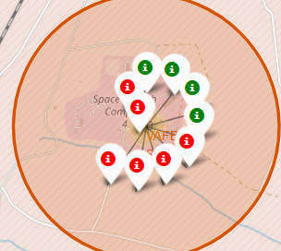
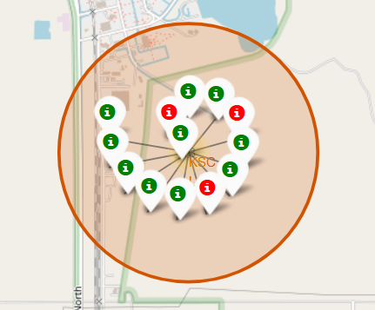
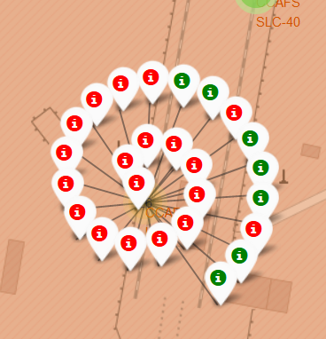
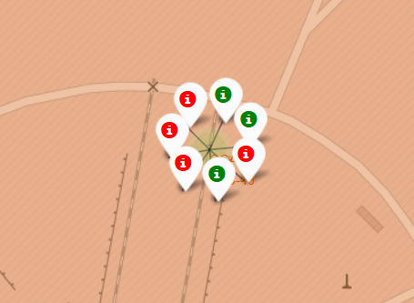
Folium Mapping – Launch Success
SLC-40
Kennedy Space Center
Vandenberg
LC-40
Explain the important elements and findings on the screenshot

Slide 37
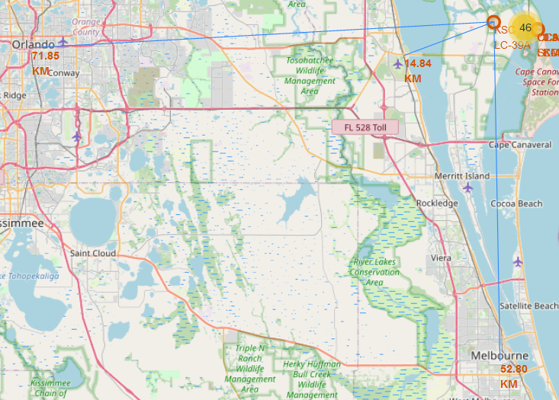
Folium Mapping – Distance to Landmarks
This Folium map depicts the distance form the Kennedy Space Center to the two closest cities and the closest interstate highway.
Not pictured: The distance from CCAFS to the coastline
Distances:
Orlando: 71.85km
Melbourne: 52.80km
US1: 14.84km
Coastline: 0.89km

Slide 38

Section 4

Slide 39
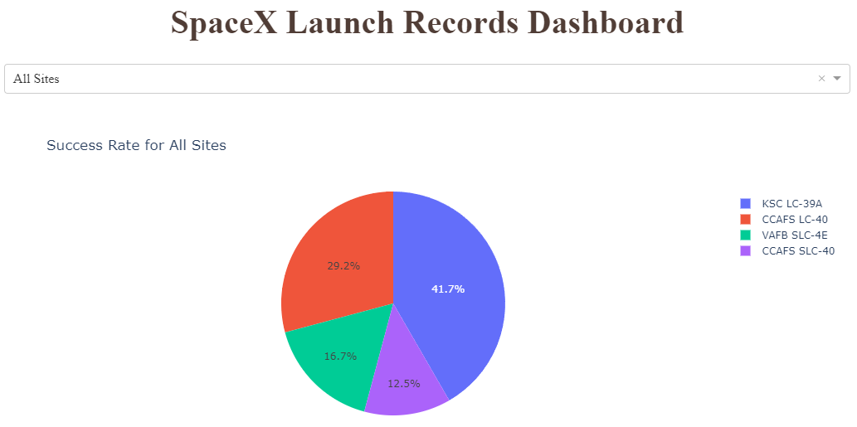
Launch Success Count for all Sites

Slide 40
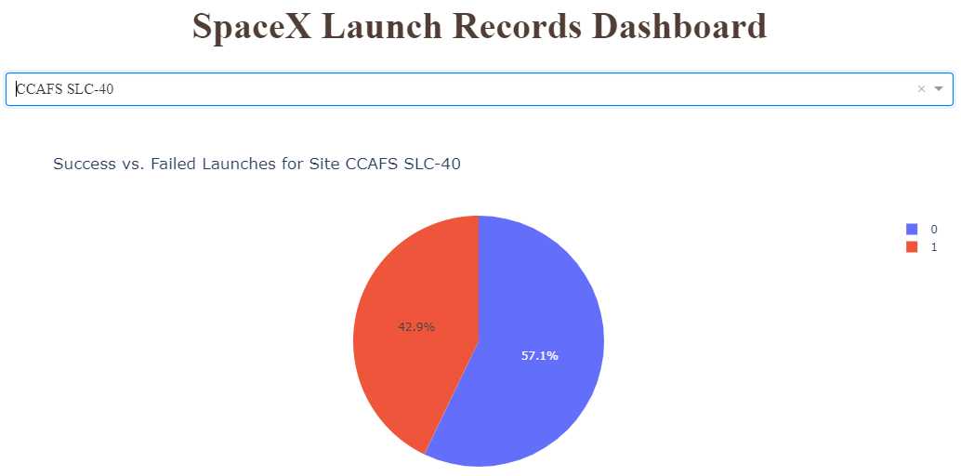
Launch Site with Highest Launch Success

Slide 41
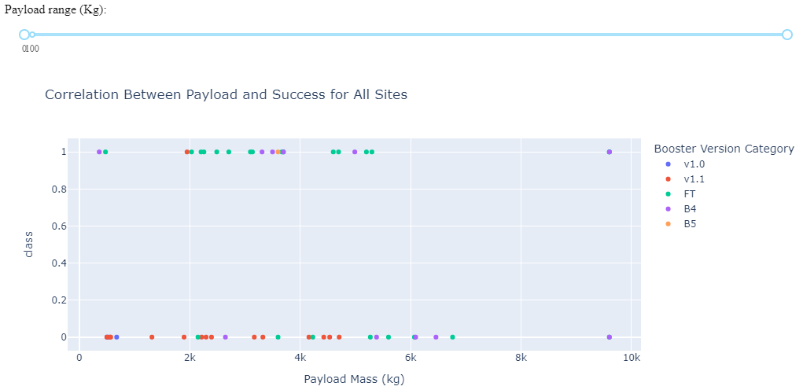
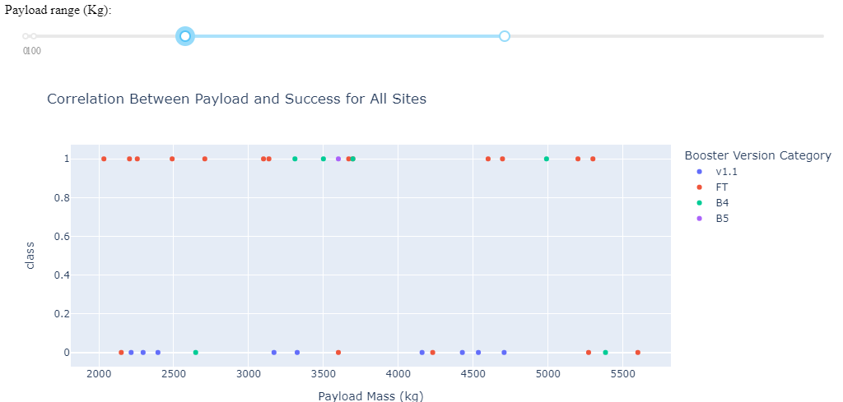
Payload vs. Launch Outcome for All Sites

Slide 42

Section 5

Slide 43
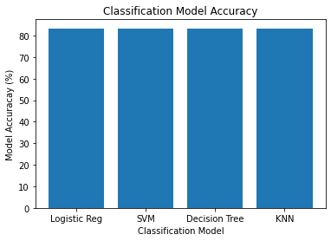
Classification Accuracy
When used to classify the test data set, each model type has the same performance of 83.33%
Some specific model parameters:
LogReg: C=1, penalty=l2, solver=lbfgs
SVM: C=1, gamma=0.0316, kernel=sigmoid
Tree: criterion=entropy, depth=4, splitter=random, features=auto, leaf=1, split=2
KNN: neighbors=6, algo=auto, p=1

Slide 44
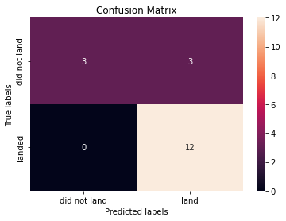
Confusion Matrix
As all models had the same performance, this confusion matrix represents all four

Slide 45
Conclusions
The decision tree model seemed to be the only model that varied from one test to another (i.e., using different random splits. This is the best accuracy observed
It make sense that the Logistic Regression model and SVM model have similar performance, as the SVM best performed using a Sigmoid Kernel – the same basis for a Logistic Regression model
Despite high accuracy scores, the confusion matrix shows that the errors were in the False Positive category which, in this context are a slightly worse error; we have predicted a landing, when there in fact was a failure

Slide 46
Appendix
Project Github Page: https://github.com/ndriscoll20/IBMDataScience/tree/master/DataScienceCapstone/jupyter_notebooks
Plotly Dash python code:
https://github.com/ndriscoll20/IBMDataScience/blob/master/DataScienceCapstone/python_code/capstonePlotlyDash.py
Data Visualization with Pandas Notebook: https://github.com/ndriscoll20/IBMDataScience/blob/master/DataScienceCapstone/jupyter_notebooks/DataScienceCapstone_EDA_dataviz_pandas.ipynb
Machine Learning/Landing Prediction Notebook: https://github.com/ndriscoll20/IBMDataScience/blob/master/DataScienceCapstone/jupyter_notebooks/DataScienceCapstone_MachineLearning.ipynb

Slide 47


